Slide 1
Predicting Student Success: A Data Driven Approach to Improving Retention
An advanced analytics model to proactively identify at-risk students and enable targeted, timely interventions.

Slide 2



The High Cost of Attrition: An Institutionai Challenge
The Business Problem
How can an institution optimise its student support services to improve retention rates and protect tuition revenue?
Key Performance Indicators (KPIs) for Success
Retention
Uplift
The measurable percentage increase in students who remain enrolled year-over-year compared to a pre-AI baseline.
Intervention Lead Time
The number of weeks of advance warning the model provides before final exams, giving giving counsellors a viable window to act. A minimum 4-week window is the goal.
Cost-Benefit Ratio
The financial gain from retained tuition versus the cost of intervention and model maintenance.
Faculty and counsellors have limited time; they require a prioritized list of students who are most likely to drop out, allowing for proactive intervention.

Slide 3
Framing the Data Science Solution
The Learning Task
The Data Foundation
Defining Technical Success
Type: Supervised Binary Classification.
Objective: To predict whether a student will ultimately ’Dropout’ or ’Graduate.
Target Variable: A binary outcome derived from the student's final status.
Source: The dataset originates from a higher education institution in Portugal, encompassing a rich set of multimodal features.
Scope: It contains 4,424 records of undergraduate students across 17 degree programmes, with 37 distinct features including demographics, prior academic qualifications, and first-year performance data.
Given the high cost of missing a student who is at risk (a False Negative), the model will be optimised to maximise Recall and Area Under the Precision- RecallCurve (AUPRC), rather than simple accuracy.
Recall (Sensitivity) is the primary technical metric, as the goal is to identify the highest possible percentage of true at- risk students.

Slide 4
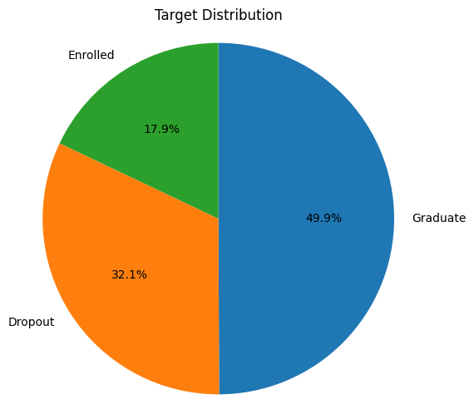
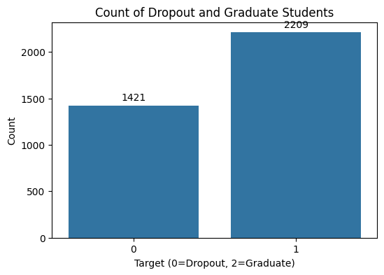
Understanding the Target Population
The raw dataset includes three student outcomes: 'Graduate', 'Dropout', and 'Enrolled'. For a predictive model, we focus on the two definitive final outcomes.
Class Imbalance
After filtering for definitive outcomes, a significant class imbalance is evident. The 'Graduate' class is considerably larger than the 'Dropout' class.
Initial Distribution of All Students

Slide 5
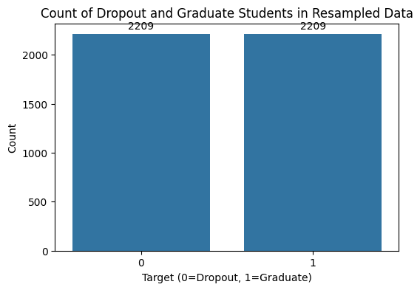

Creating a Balanced Foundation for Modelling
Training a model on an imbalanced dataset would create a bias towards the majority class (‘Graduate’), severely compromising its ability to detect the minority class (’Dropout’), which is our primary objective. To solve this, the minority class was oversampled to match the majority class, creating a perfectly balanced dataset for training.
Before vs. After
Oversampling
Original Imbalanced Data
Resampled Balanced Data for Training

Slide 6
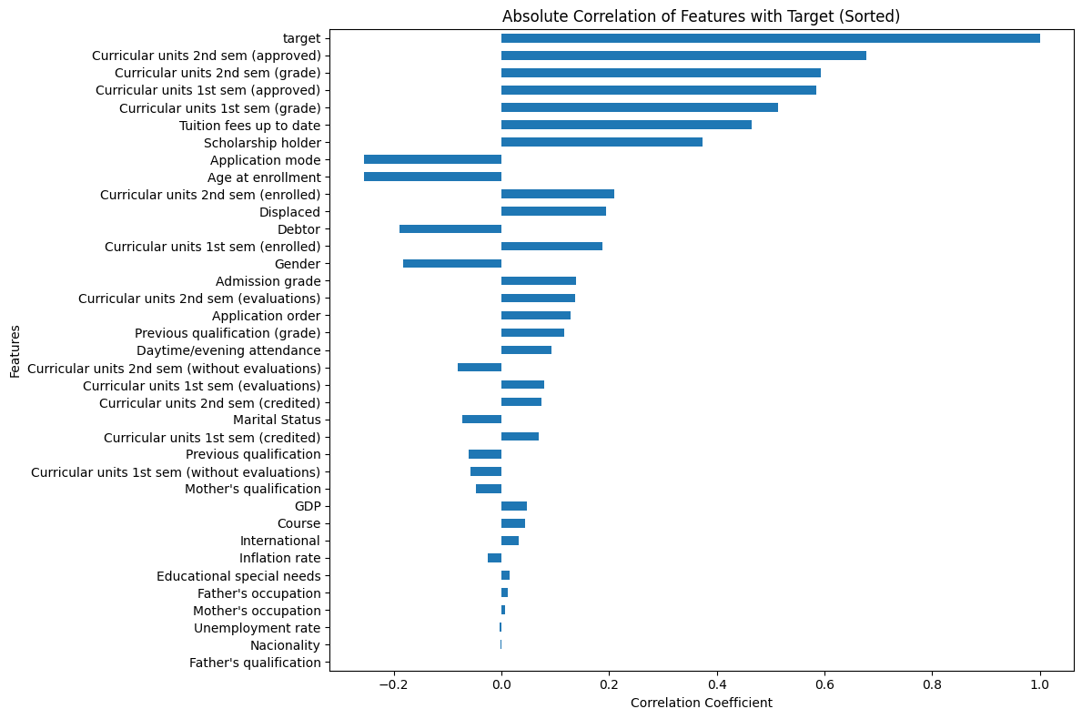
What Factors Drive Student Success? A Look at Feature Correlation
An analysis of the absolute correlation between each feature and the target outcome reveals the key predictors of student success. Academic performance indicators from the first and second semesters are overwhelmingly the most influential factors.
Top Predictors
The strongest signals come from academic achievement: "Curricular units 2nd sem (approved)', 'Curricular units 2nd sem (grade)", and ‘Curricular units 1st sem (approved)'.
Financial Signal
"Tuition fees up to date" also shows a strong positive correlation with graduating.
Demographic Signal
"Age at enrollment" is a notable factor, with older students showing a higher tendency to drop out.

Slide 7
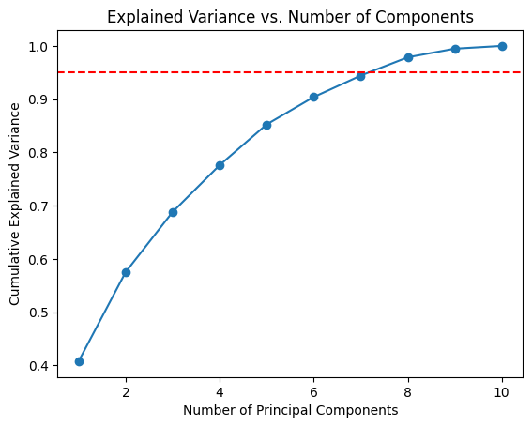
Feature Engineering
With the use of Recursive Feature Elimination (RFE) , we have selected the top 10 most impactful features namely:
1. Course
2. Previous qualification (grade)
3. Admission grade
4. Tuition fees up to date
5. Age at enrollment
6. Curricular units 1st sem (approved)
7. Curricular units 1st sem (grade)
8. Curricular units 2nd sem (evaluations)
9. Curricular units 2nd sem (approved)
10. Curricular units 2nd sem (grade)
To further reduced the number of features we decided to implement Principal Component Analysis (PCA). We have chosen to reduce the features to 8 PCA components because it is the least number of components that will provide more than 95% cumulative variance.

Slide 8
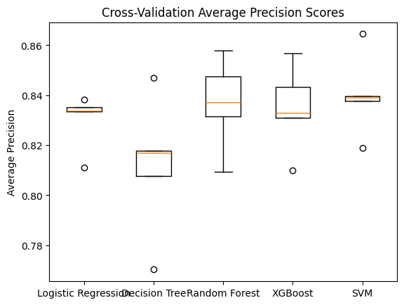
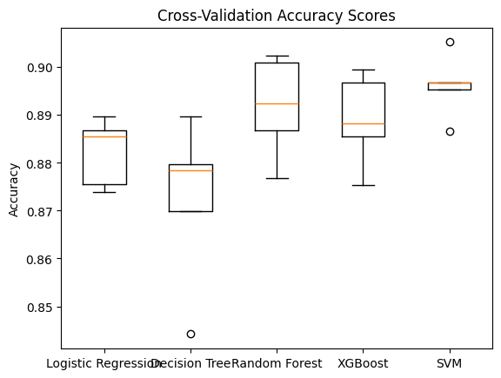
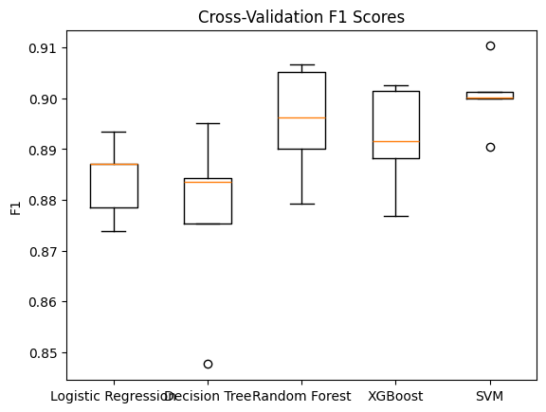
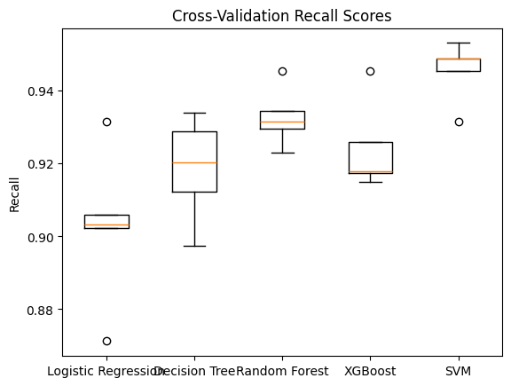
A Tournament of Champions: Selecting the Best Predictive Model
Five distinct classification models were trained (with the best Hyper-Parameters) and evaluated using 5-fold cross-validation to ensure robust and generalizable performance. The models were compared on four key metrics critical for this classification task.
The SVM model demonstrates consistently high performance across all key metrics, particularly showing a highest median and tight interquartile range for Recall and F1-Score, indicating both strong predictive power and stability.

Slide 9


The Chosen Solution: A Fine-Tuned Random Forest Model
Based on its superior and highly stable performance during cross-validation, the Support Vector Machine (SVM) classifier was selected as the final model. It was then trained on the full pre-processed dataset.
Winning Model Performance
The model achieved an outstanding Recall of 0.95 and an F1-Score of 0.91 for the ’Graduate’ class on the held-out test set, demonstrating its effectiveness at correctly identifying students on the path to success.
Crucially, for the ’Dropout’ class, it maintained high performance, ensuring that at-risk students are not missed.
The Final Engineered Pipeline (svc_pipeline. joblib)
The entire workflow, from data preparation to the final prediction, has been encapsulated into a single,
serialised pipeline object for robust deployment.
Recursive Feature Elimination (RFE) – Top 10
Principal Component Analysis (PCA)
(8 Components)
Support Vector Machine (SVM)
Raw Data
Standard Scaler
Prediction

Slide 10
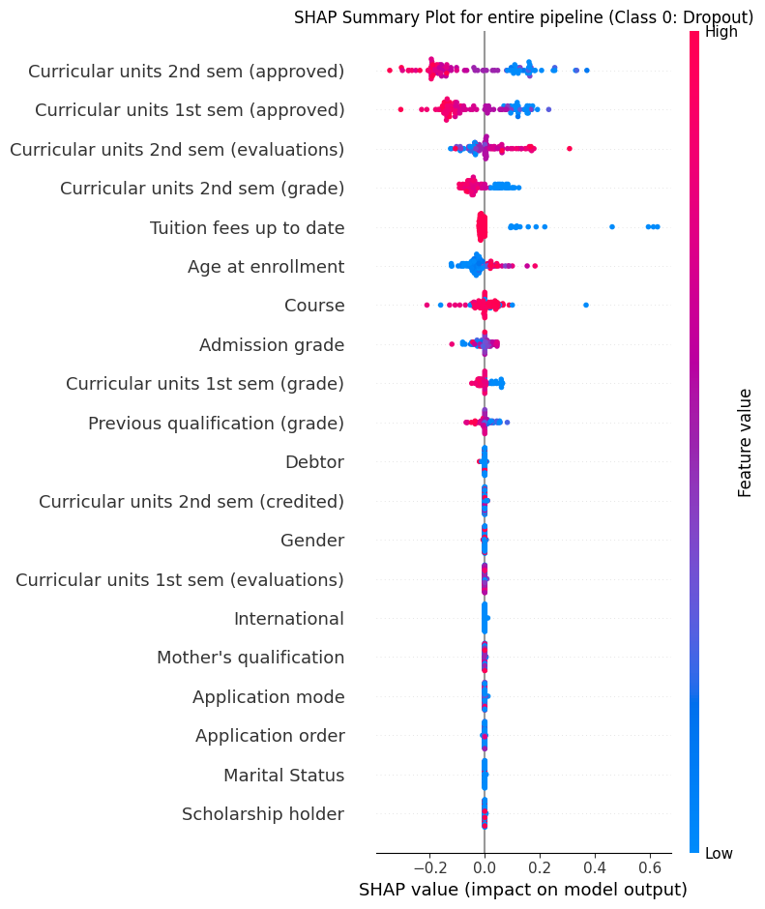
Building Trust: Understanding the Model's Logic on a Global Scale
To ensure the model is not a 'black box', SHAP (SHapley Additive exPlanations) values were calculated. This reveals how each feature impacts the model's output across the entire dataset. The plot below shows the top 20 features, ranked by their importance.
Interpretation
Horizontal Axis
The SHAP value (impact on model output). Positive values push the prediction towards "Dropout".
Feature Importance
"Curricular units 2nd sem (approved)" is the most important feature.
How to Read
Y-axis: Features ranked by importance (top = most influential)
X-axis: SHAP value = impact on model output (positive = pushes toward dropout, negative = pushes away)
Dots: Each dot = one student
Color: Feature value (blue = low, red = high)
Position: SHAP value (left = pushes toward dropout, right = pushes away)
For the top feature, low values (blue dots) have a high positive SHAP value, strongly increasing the likelihood of a "Dropout" prediction. High values (red dots) have a negative SHAP value, decreasing that likelihood.
Key Insight
Poor academic performance (low approved units, low grades) is the single most powerful driver of a ’Dropout" prediction.

Slide 11
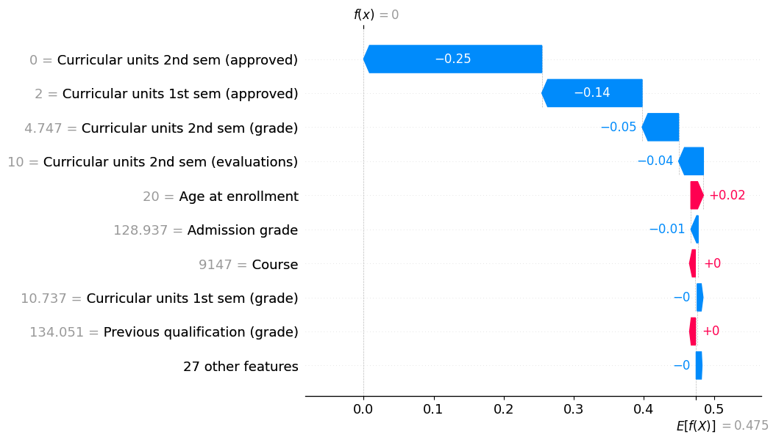
From Global Trends to an Individual Story: Explaining a Single Prediction
SHAP can also explain the prediction for a single student. The waterfall plot below shows the features that pushed the model's prediction away from the baseline (average prediction) to its final decision for one specific student flagged as being at risk of dropping out.
Case Study Analysis
Baseline
The average prediction probability is 0.475 (E[f(X)]).
Negative Drivers (Pushing towards Dropout)
This student's outcome was heavily influenced by having 0 approved units in the 2nd semester (-0.25 impact) and 0 approved units in the 1st semester (-0.14 impact).These factors were the primary reasons for the at-risk flag.
Positive Drivers (Pushing towards Graduate)
A relatively high ’Age at enrollment(+0.02 impact) slightly counteracted the negative factors but was not strong enough to change the outcome.
Final Prediction
The sum of these feature impacts results in the final prediction of f(x) - 0 ("Dropout").

Slide 12
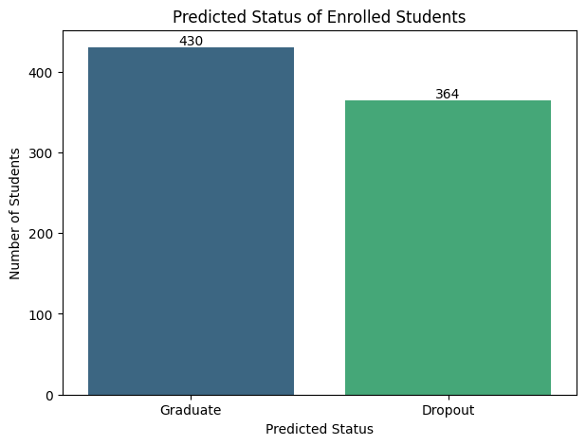
The Payoff: Predicting the Future for Currently Enrolled Students
The true value of the model lies in its application to students whose outcomes are not yet known. The final pipeline was used to predict the future status of the 794 students currently marked as “Enrolled”.
“Predicted to Graduate”:
“Predicted to Dropout":
430 students are predicted to be on track for graduation.
364 students are flagged by the model as being at high risk of attrition.
Key Takeaway: The model has generated a high-priority, data-validated list of 364 students for
immediate proactive outreach by academic advisors and support staff.

Slide 13



From Prediction to Proactive Support: Summary and Future Directions
Project Impact Summary
Problem: High student attrition presents a significant institutional and financial challenge.
Recommendations and Next Steps
Deployment: Integrate the ‘svc_pipeline.joblib’ model into a secure dashboard for academic advisors to view at-risk student lists in near real- time.
Refinement: Continuously retrain the model with new student data each semester to adapt to changing trends and maintain high accuracy.
Expansion: Explore the integration of additional data sources, such as virtual learning environment (VLE) engagement logs, to further enrich the feature space and enhance predictive power.
Solution:
A robust and interpretable SVM model,
encapsulated in a deployment-ready pipeline, was
developed to predict student outcomes.
Impact: The model provides an actionable list of 364 currently enrolled students at high risk of attrition, enabling a shift from reactive to proactive support and optimising the use of counselling resources.

